Slide 1
Project Presentation of Industry Oriented Hands on Experience (22CS422)
On
Cross Layer Security Platform
Vardhman Jain
2210992513
Supervised By
Dr. PK Khosla
Department of Computer Science and Engineering,
Chitkara University, Punjab

Slide 2
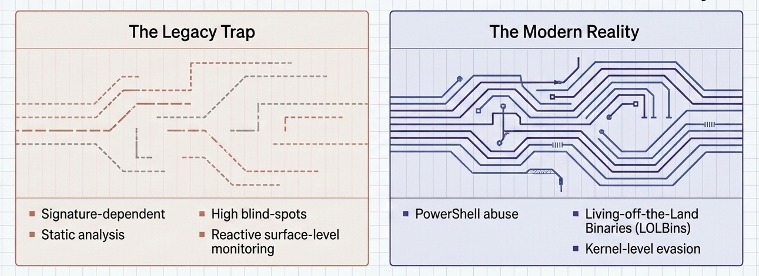
Introduction
The Modern Threat Landscape
Traditional antivirus solutions, hampered by their reliance on static signature-based detection, are fundamentally ill-equipped to counter the current generation of sophisticated adversaries. Modern security operations face several critical structural challenges:
Advanced Evasion: PowerShell abuse, and LOLBins hide malicious activity within legitimate processes.
Kernel-Level Bypass: Attackers evade traditional user-mode monitoring using low-level techniques.
Delayed Containment: Manual event correlation increases dwell time before threats are isolated.
2

Slide 3
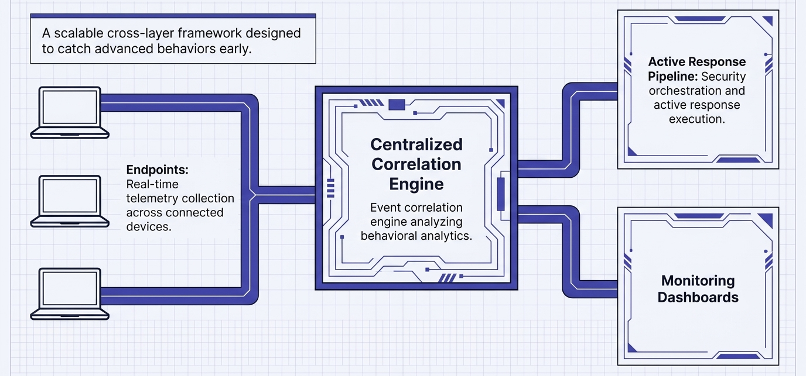
Methodology
Architectural Framework
The architecture leverages a centralized, high-throughput framework designed to ingest and correlate high-fidelity data from distributed environments. The operational flow is orchestrated as follows:
Distributed Telemetry Collection: Multiple managed endpoints transmit continuous, real-time telemetry streams to the central platform.
Centralized Monitoring: Data is aggregated into a unified dashboard, providing high-definition threat visibility across the enterprise.
Active Response Pipeline: Validated detections trigger automated active response workflows for immediate threat containment.
Monitoring Dashboards: An integrated dashboard that displays security information like logs and connected endpoint.

Slide 4
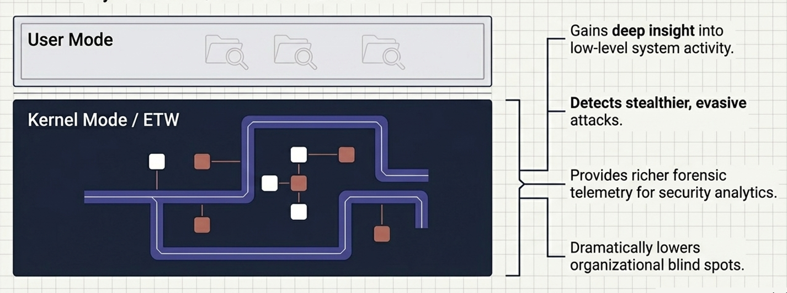
Core Telemetry Integration
The platform primarily uses Sysmon for endpoint telemetry and forensic visibility, with additional integration of Event Tracing for Windows (ETW) for kernel-level monitoring. ETW enhances detection by reducing reliance on user-mode hooks, helping uncover stealthy system-level activities often missed by traditional EDR solutions.

Slide 5
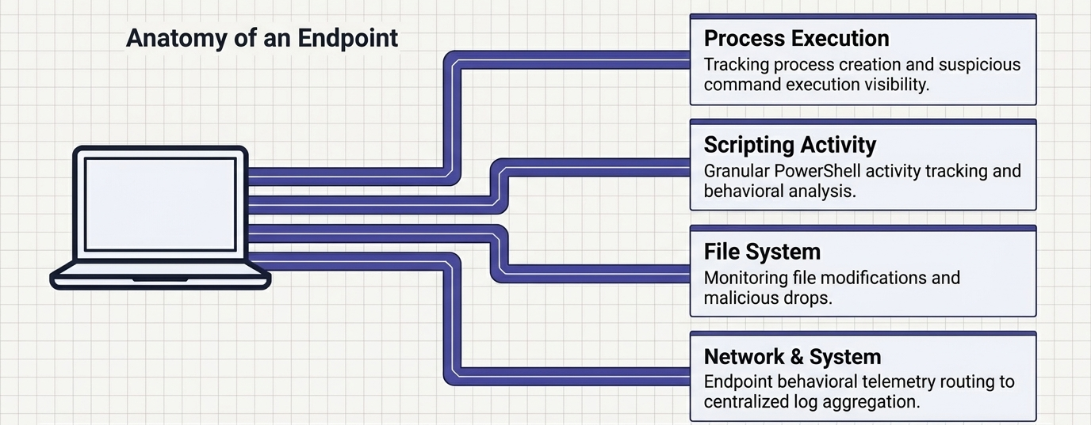
Telemetry Collection Pipeline
The pipeline includes robust monitoring of high-risk activities to maintain total environmental visibility. Specific focus areas include:
Process Execution Monitoring: Lifecycle tracking of all processes to detect unauthorized execution or malicious process hollowing.
PowerShell Activity Tracking: Deep inspection of script execution to identify obfuscation and administrative tool abuse.
File Activity Monitoring: Real-time logging of unauthorized file "drops," modifications, and suspicious payload delivery.
Suspicious Command Execution: Monitoring for LOLBin exploitation and command-line arguments indicative of discovery or credential theft.

Slide 6
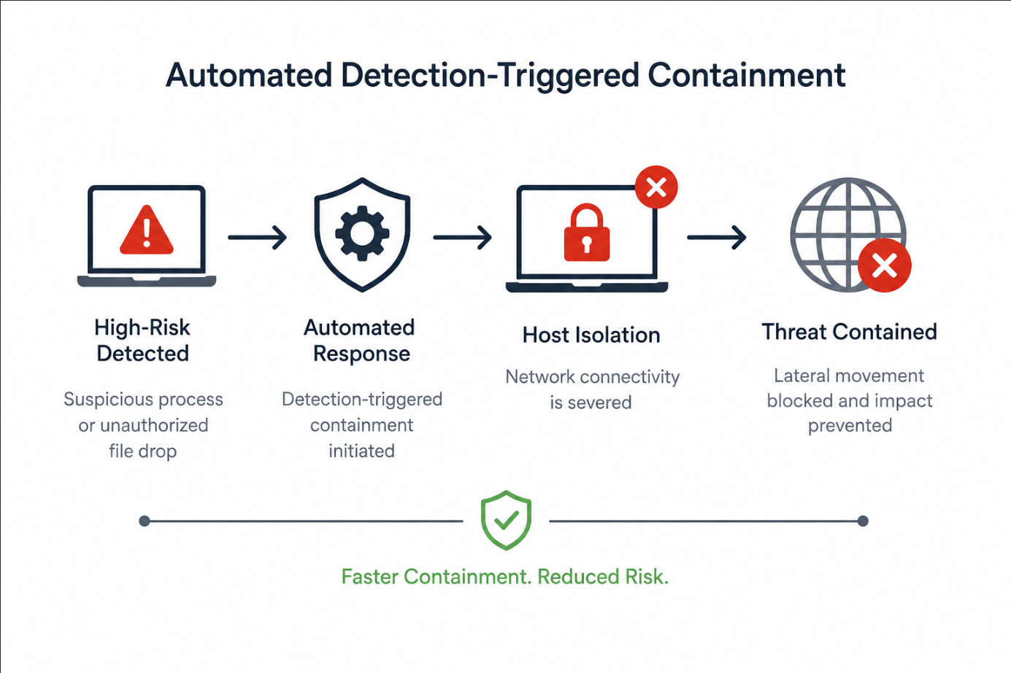
Active Response
To minimize attacker dwell time, the platform uses automated active response workflows. Upon detecting high-risk activity—such as suspicious processes or unauthorized file drops—it automatically triggers Host Isolation, cutting network connectivity to prevent lateral movement and contain the threat.

Slide 7
Major Findings and Outcomes
Detection Engineering Capabilities
The platform has demonstrated its value as a premier "Detection Engineering Lab," providing the infrastructure necessary for continuous security improvement. This environment enables:
Rule Validation: Rapid testing and iterative refinement of behavioral detection rules against real-world telemetry.
Pipeline Stress-testing: Assessing the throughput and reliability of telemetry streams under high-load scenarios.
Response Tuning: Fine-tuning the sensitivity and logic of automated containment workflows to minimize operational friction.
Operational Impact
The implementation of this framework marks a definitive shift from a "Simple EDR" to a comprehensive "Cross-layer security platform." By leveraging advanced Security Analytics, the organization has transitioned from a reactive posture to a proactive defense model. The operational outcome is a platform that provides deep forensic telemetry and the capability for near-instantaneous threat containment.

Slide 8
Conclusion and Future Scope
This project successfully delivers a scalable, modular platform that achieves deep endpoint visibility and rapid response. By prioritizing kernel-level telemetry and automated detection pipelines, the architecture establishes a formidable defense capable of securing the enterprise against the modern attack techniques that bypass traditional security solutions.
Future Roadmap
The strategic vision for the platform includes the following architectural advancements:
XDR Integration: Expanding visibility beyond the endpoint into network and cloud security layers.
ML-Assisted Anomaly Detection: Utilizing machine learning to identify sophisticated deviations from established behavioral baselines.
Cross-Platform Support: Extending high-fidelity telemetry and response capabilities to macOS and Linux environments.
Threat Intelligence Enrichment: Integrating real-time external intelligence feeds to increase the precision of behavioral rules.
Threat Hunting Capabilities: Deploying specialized security analytics tools for proactive discovery of persistent, undetected threats.

Slide 9
Thank You
9

